Slide 1
Popular Models
Mohammad ghoddosi

Slide 2

VGG16

Slide 3
Goolenet (ideas)
We need to go deeper
Vanishing gradient
1x1 Convolution
Dimension reduction
Inception module
Global Average Pooling
Auxiliary Classifiers

Slide 4
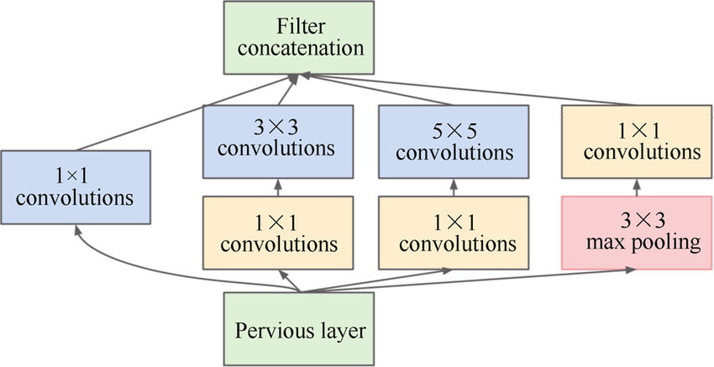
GoogleNet (inception module)

Slide 5
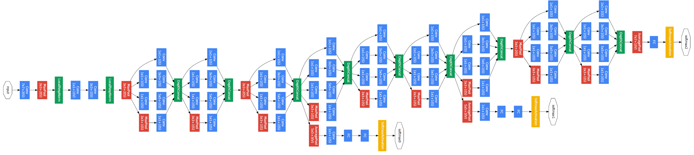
GoogleNet

Slide 6
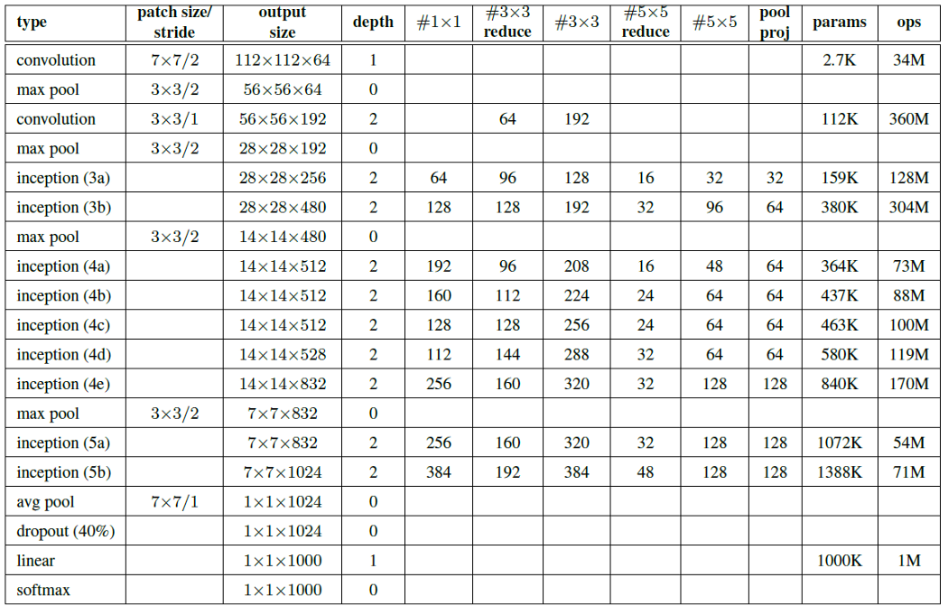

Slide 7
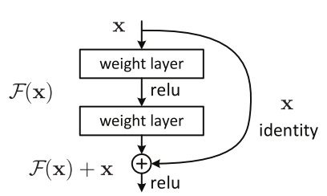
ResNet (residual block)

Slide 8
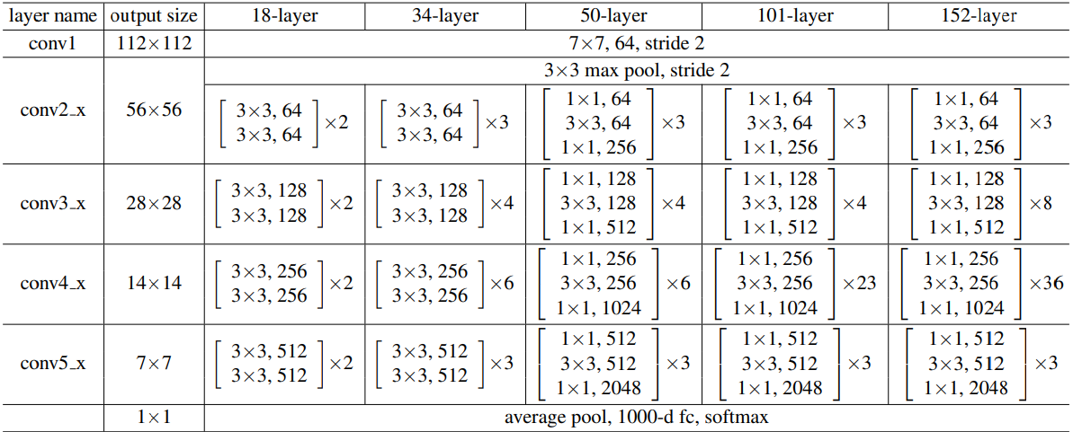
Resnet

Slide 9
Mobilenet (ideas)
Significant reduction in number of parameters. (same depth)
Lightweight deep neural network
Depthwise separable convolution
Depthwise convolution
Pointwise convolution

Slide 10
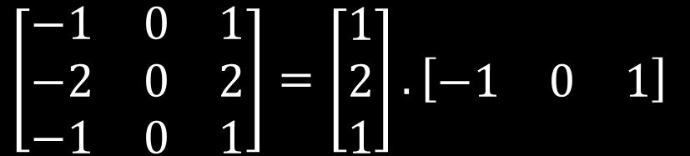
Mobilenet (convolution)
We can separate dimensions:
From 9 parameters to 6 parameters
Lower operations
We can apply this for depth to
$$\left[\begin{matrix}−1 & 0 & 1 \\ −2 & 0 & 2 \\ −1 & 0 & 1\end{matrix}\right]=\left[\begin{matrix}1 \\ 2 \\ 1\end{matrix}\right].\left[\begin{matrix}−1 & 0 & 1\end{matrix}\right]$$

Slide 11
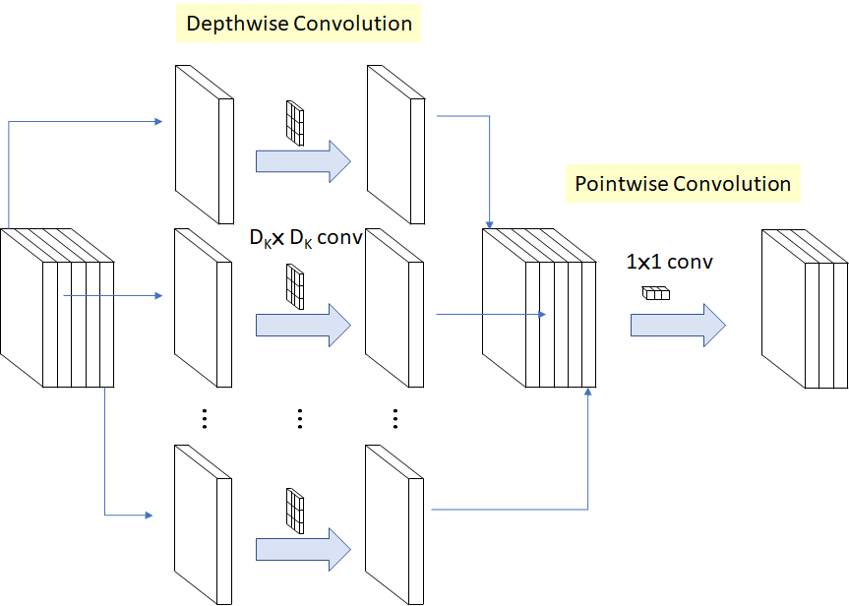
Mobilenet (convolution)
Example:
512*512 input image
3*3 filters
64 input depth
128 output depth
Params:
Normal => 73,728
MobileNet => 704
Operations:
Normal => 38.65e9
MobileNet => 4.59e9

Slide 12
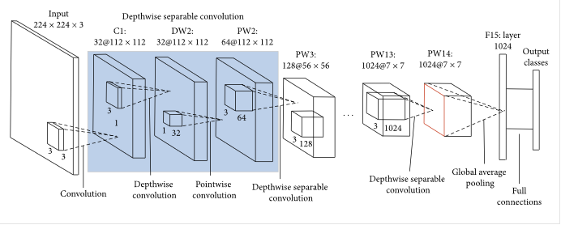
mobilenet

Slide 13
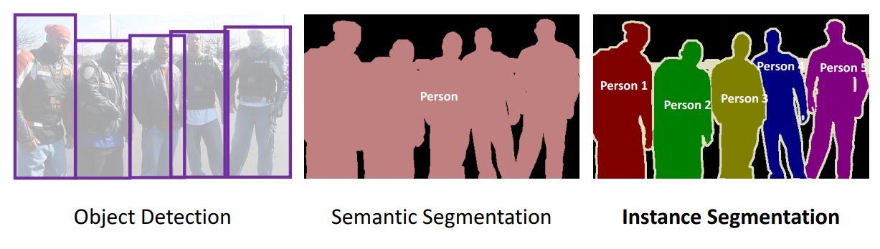
segmentation

Slide 14
U-net operations
Convolution
Pooling (down sampling)
Lose “WHERE” information
We need “WHERE” and “WHAT” information both
Up sampling
Transpose Convolution (deconvolution)
Convolution with fraction stride
Skip connection

Slide 15
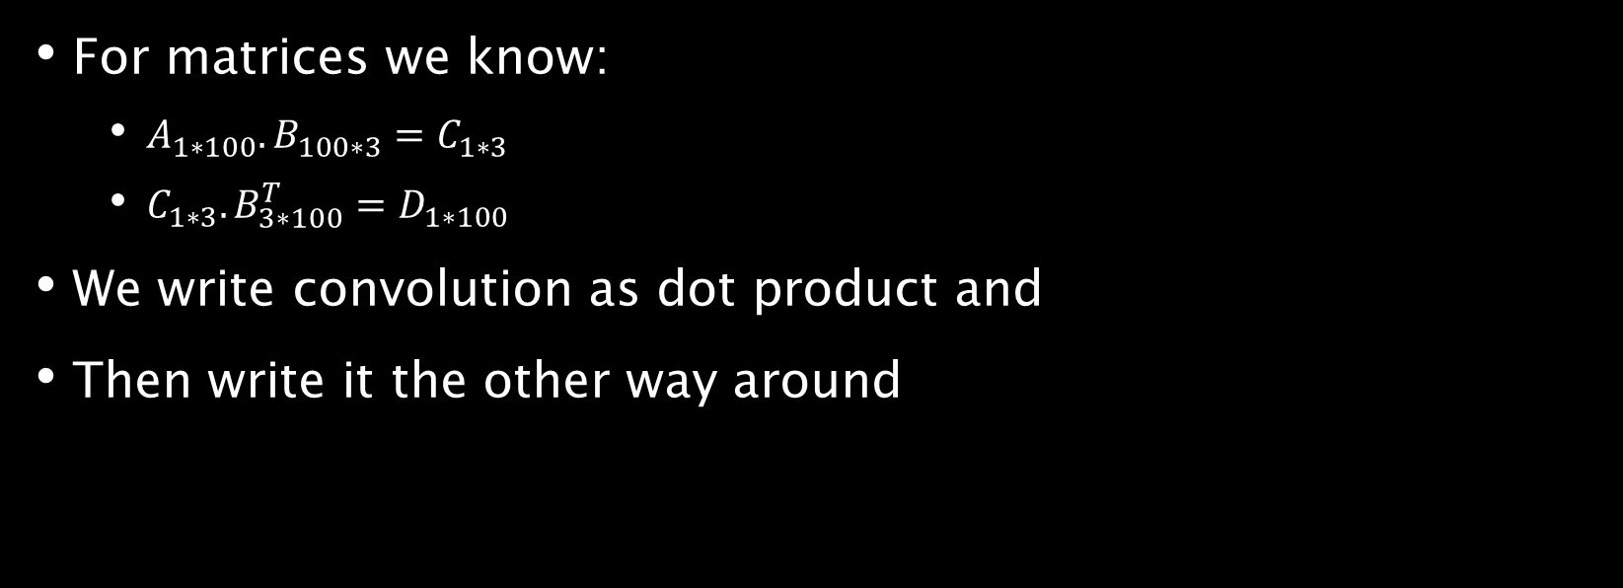
Transpose Convolution
For matrices we know:
$A_{1∗100}. B_{100∗3}=C_{1∗3}$
$C_{1∗3}.B_{3∗100}^{T}=D_{1∗100}$
We write convolution as dot product and
Then write it the other way around

Slide 16
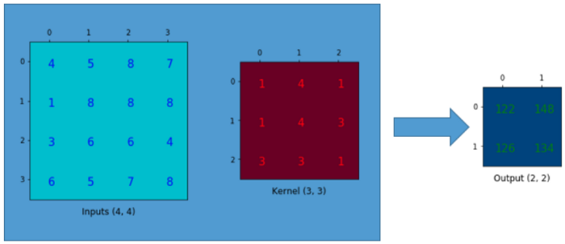
Convolution

Slide 17
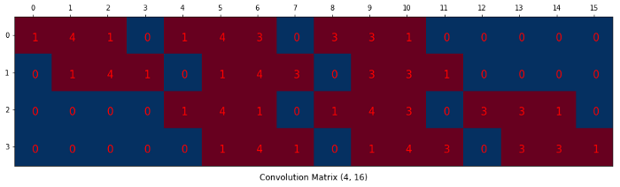
Convolution as dot product

Slide 18
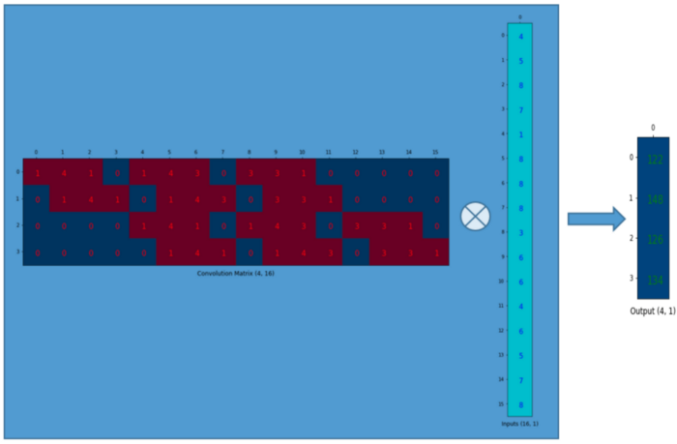
Convolution as dot product

Slide 19
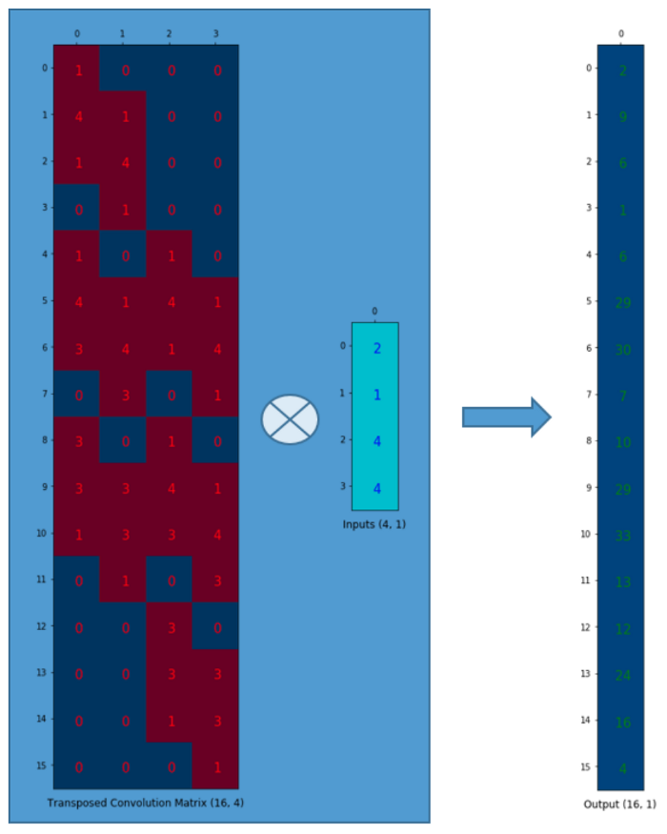
Transpose Convolution

Slide 20
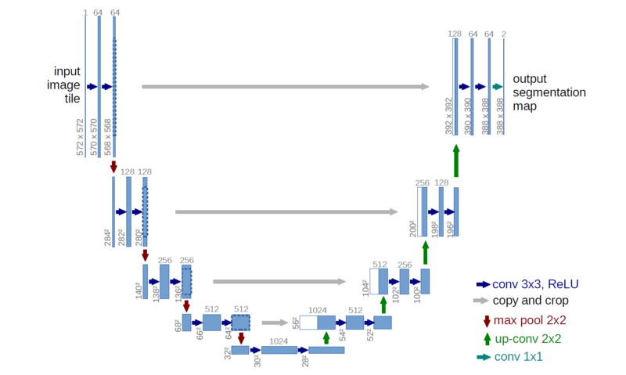
U-net architecture

Slide 21
Object Detection

Slide 22
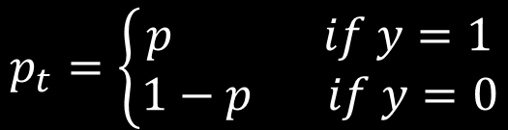
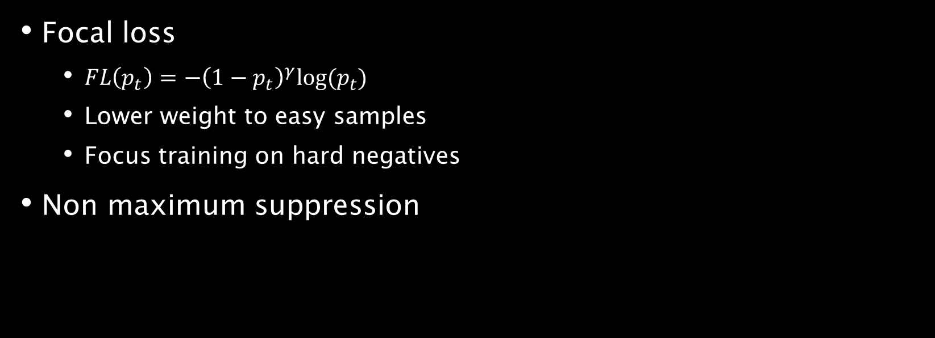
Retinanet
Focal loss
$FL\left(p_{t}\right)=−{\left(1−p_{t}\right)}^{γ}log⁡(p_{t})$
Lower weight to easy samples
Focus training on hard negatives
Non maximum suppression
$$p_{t}=\left\{\begin{aligned}p if y=1 \\ 1−p if y=0\end{aligned}\right.$$

Slide 23
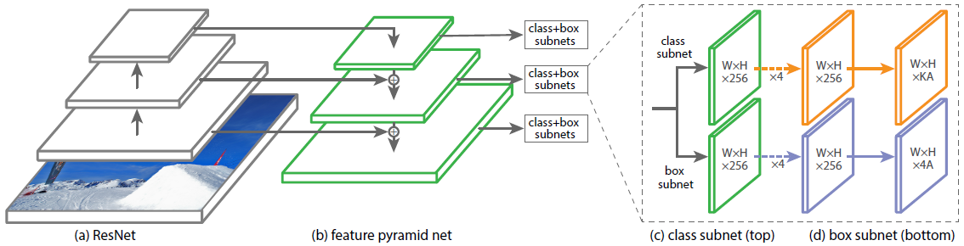
retinanet

Slide 24
Further reading
LeNet
AlexNet
ZFNet
Mask R-CNN
YOLO (You Only Look Once)
SSD (Single Shot Detector)

Slide 25

identification
Verification
Identification

Slide 26
Identification as classification
Each identity is a class
We need lots of images for each person
Its not easy to add one person
Solution -> one shot learning

Slide 27
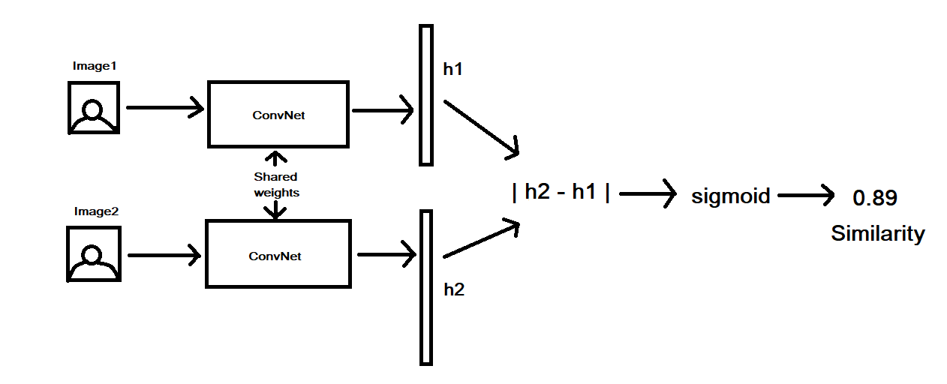
Siamese Network

Slide 28
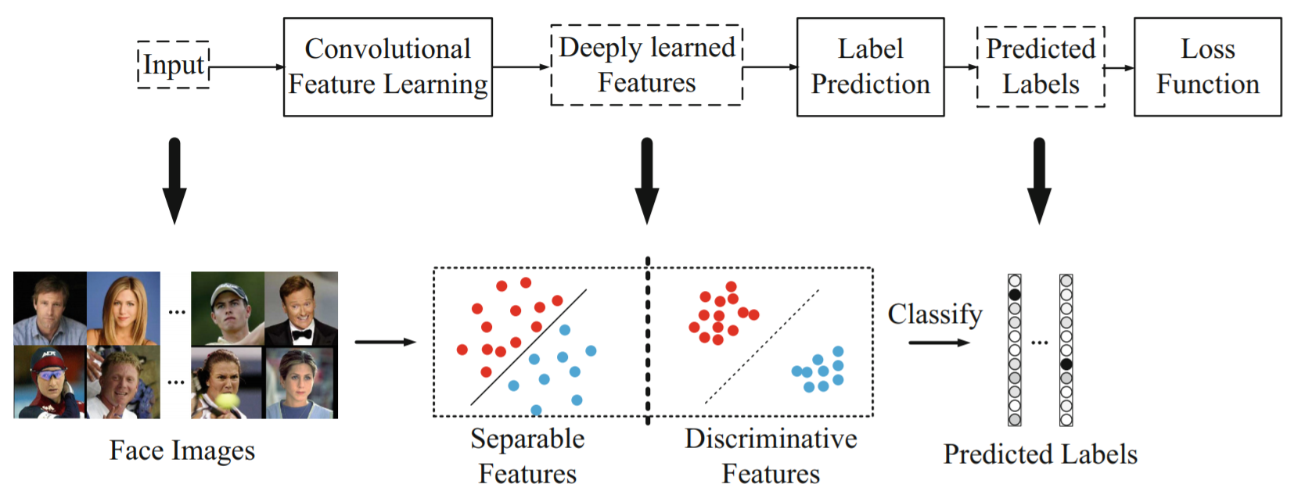
Discriminative vs separable

Slide 29
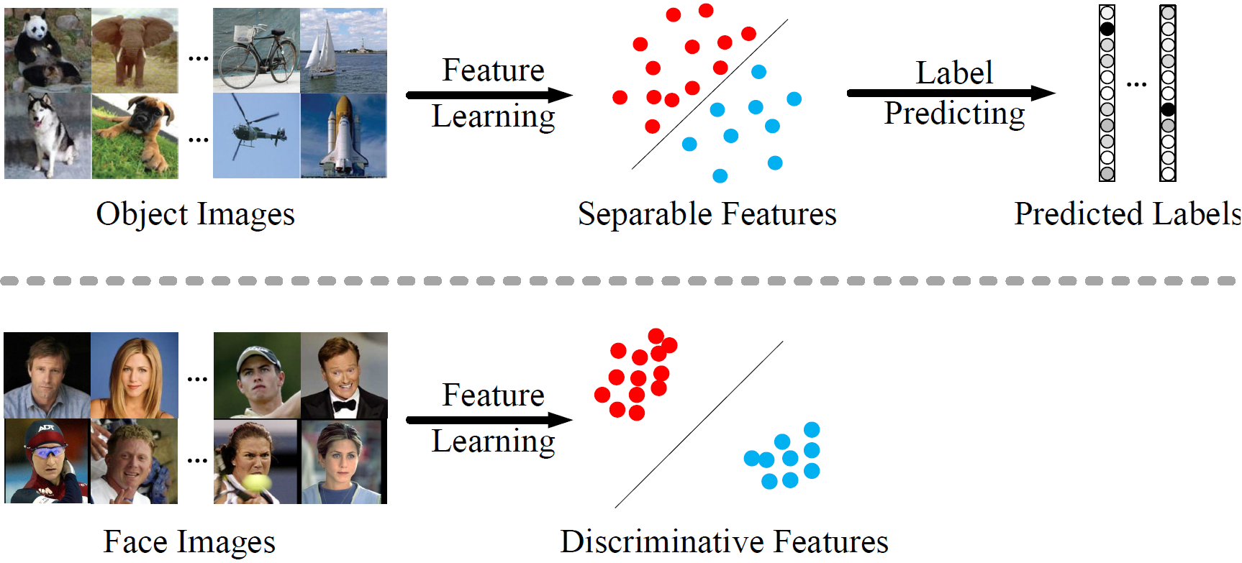
Discriminative vs separable

Slide 30
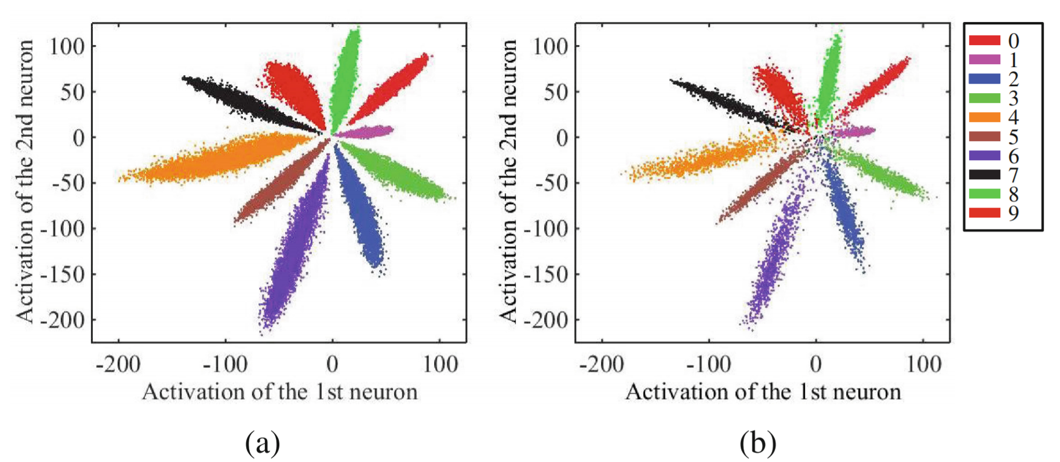
Cross entropy 2d feature space

Slide 31
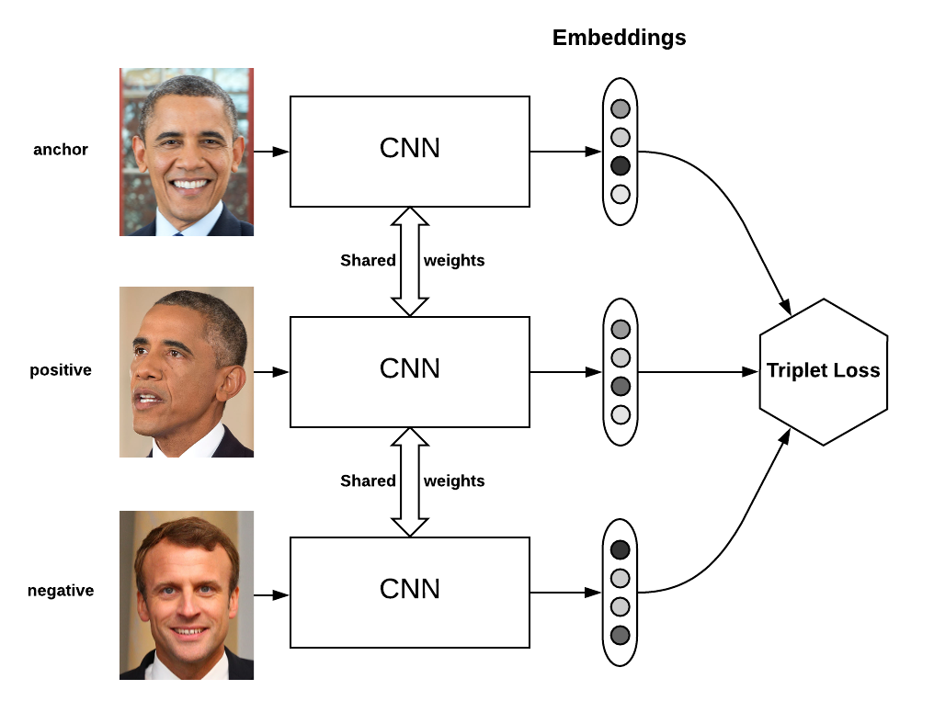
Triplet loss

Slide 32
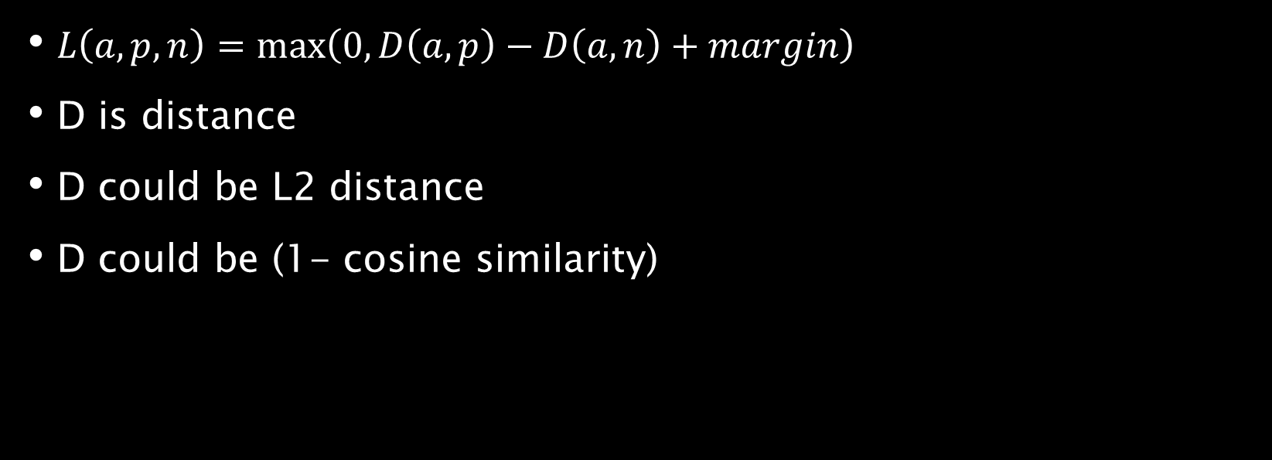
Triplet loss
$L\left(a, p, n\right)=\max\left(0, D\left(a, p\right)−D\left(a, n\right)+margin\right)$
D is distance
D could be L2 distance
D could be (1- cosine similarity)

Slide 33
Problems with triplet loss
Most triplet has no information
We can choose hard negative
Noisy data and mislabeled data
Computation is time consuming
We can choose farthest positive and nearest negative from batch
We need large batch-size (for example 1000)
Memory bottleneck

Slide 34
Center loss
We can use classification to train model
Try to hold feature vector of each class near each other
Force model to shape feature vectors as sphere
This feature space will be discriminative

Slide 35
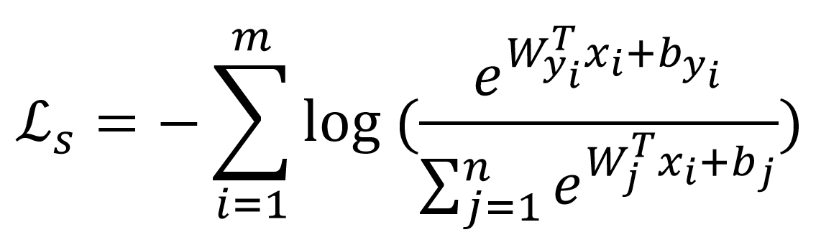
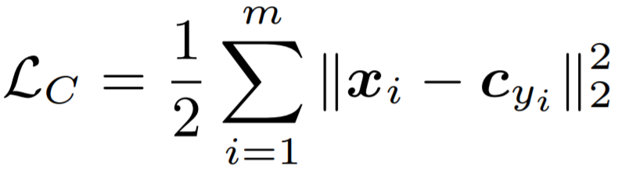
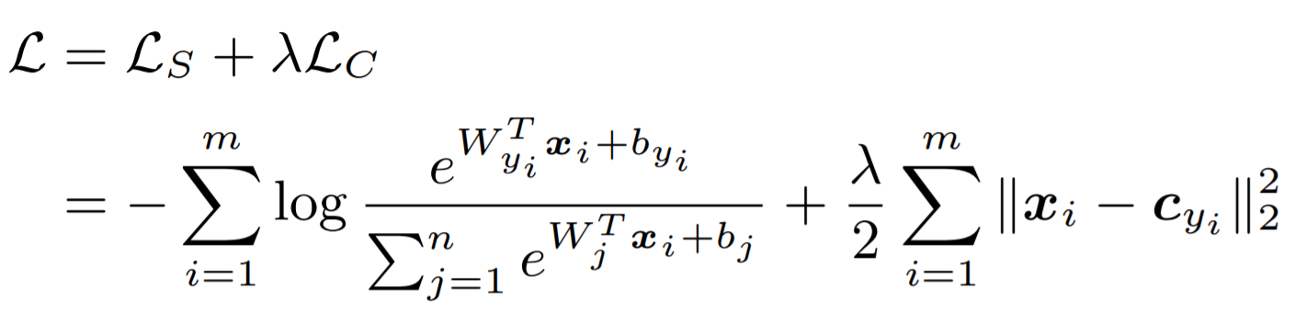
Center loss

Slide 36
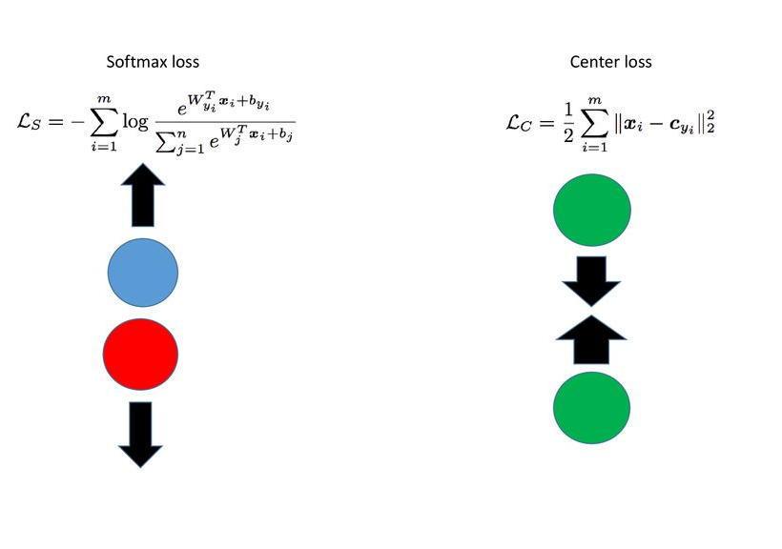
Softmax loss vs center loss
Just Softmax loss
Separable
not discriminative
Just Center loss
all feature vectors will be same
Softmax loss =>
between-class variation
Center loss =>
inter-class similarity

Slide 37
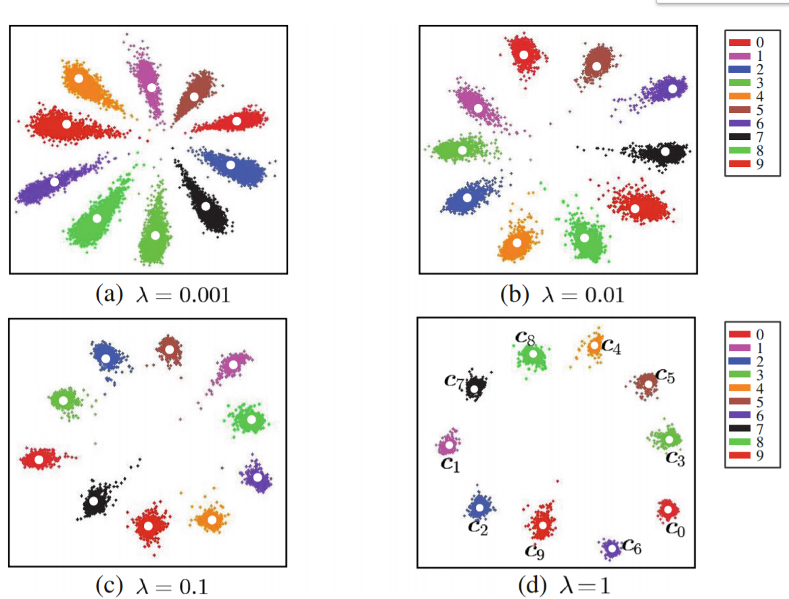
Center Loss + Cross Entropy Feature space

